Slide 1
NACCU Technology Research Committee Barton Lawyer, John Bonass, Greg Jonason, Ben Anderson, Jay Kohn

Slide 2
2018 Committee Members
Rozie Amos
University of Calgary
Ben Anderson
Tapingo
John Bonass
Villanova University
Myron Esterson
Towson University
Greg Jonason
University of Houston
Jay Kohn
Stanford University (Chair)
Barton Lawyer
Duke University
Dawn Thomas
NACCU Staff Liaison
Deric Waite
Quinnipiac University
Richard Wynn
Georgia Southern University (Board Liaison)

Slide 3
What we focused on
Card Program Highlights
Available online at NACCU
Georgia Southern University (+ video)
University of Calgary (+ video)
Towson University (+ video)
Cuyahoga Community College
Duke University

Slide 4
What we focused on
Speedy Benchmark Surveys
Available online at NACCU
Operating Budgets: The Buying Power of NACCU members
Campus Card Office Online Accessibility
IT Support for the Campus Card Program
Preferred Names
Online Photo Submission

Slide 5
Credential Vulnerabilities
Publically available technologies and services for cloning, spoofing, and forging student ID cards

Slide 6
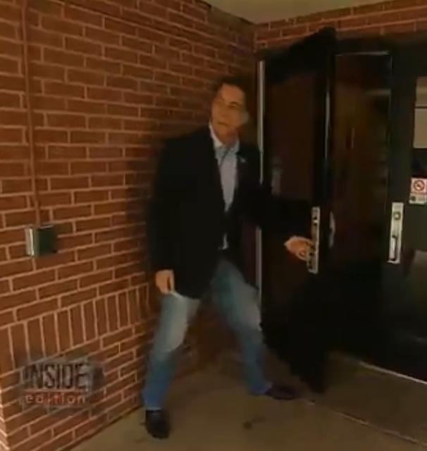
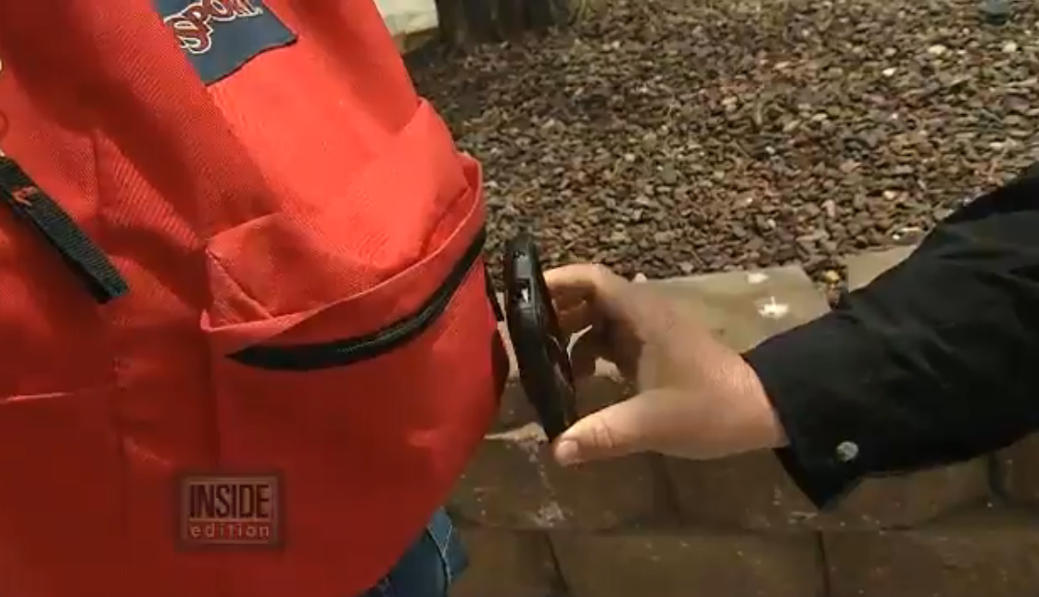
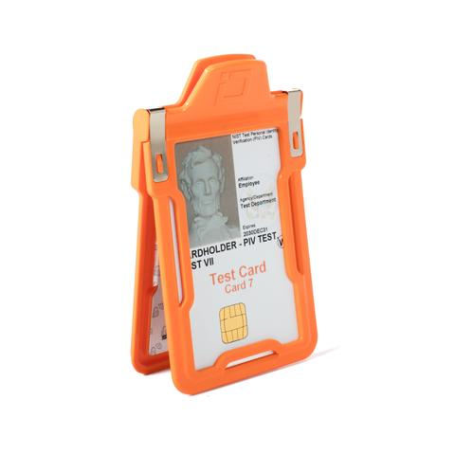
Case Study ‘Phantom’ Key Card Investigation

Slide 7
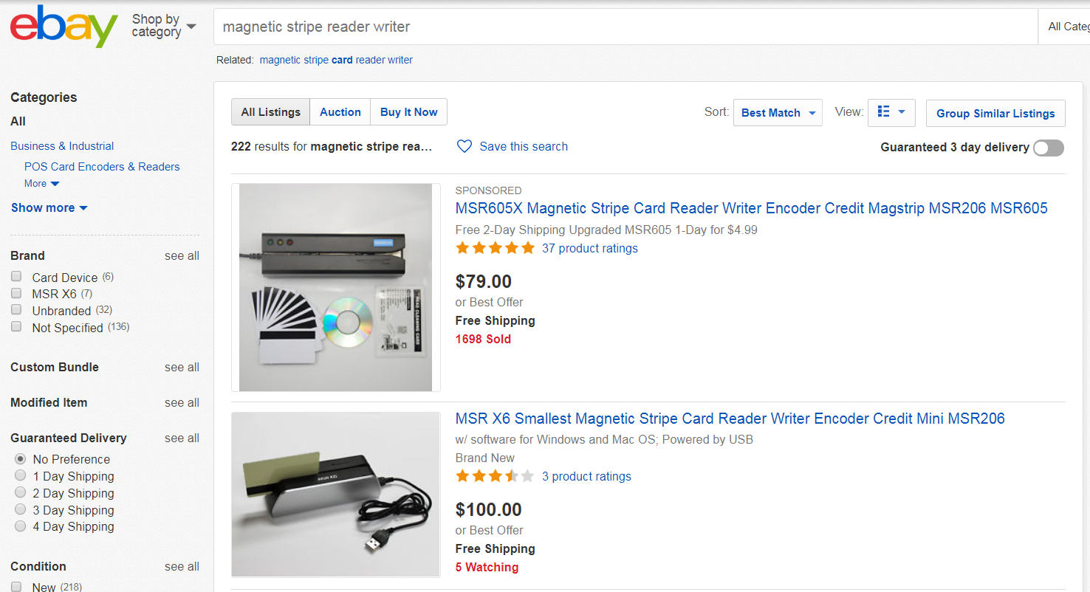
Credential Vulnerabilities – Magnetic Stripe

Slide 8
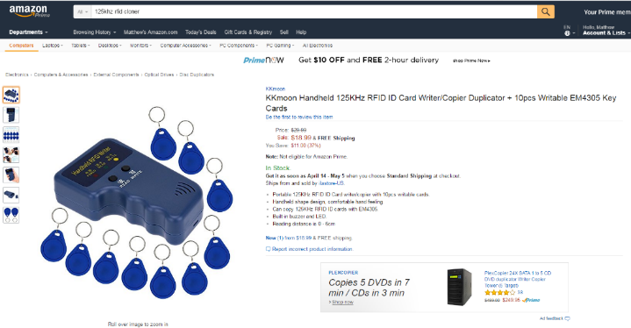
Credential Vulnerabilities – 125kHz Prox

Slide 9
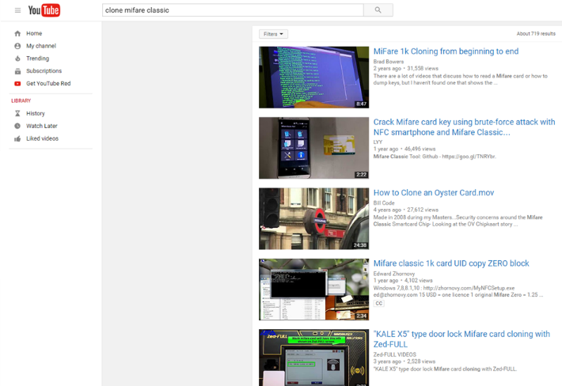
Credential Vulnerabilities – MIFARE

Slide 10

Credential Vulnerabilities – Legacy iCLASS

Slide 11

Credential Vulnerabilities – Kickstarter Chameleon

Slide 12
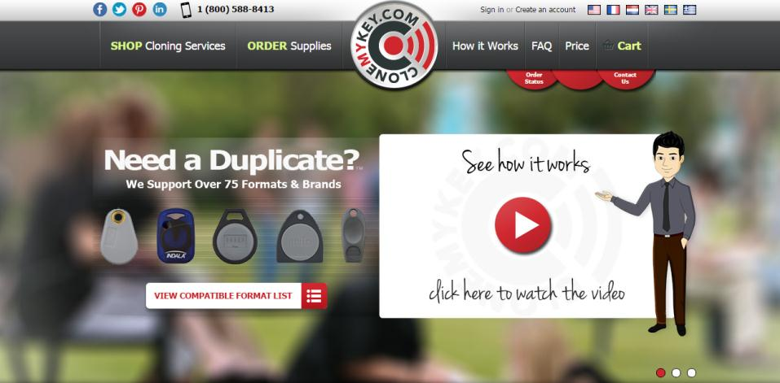
Credential Vulnerabilities – Cloning Services

Slide 13
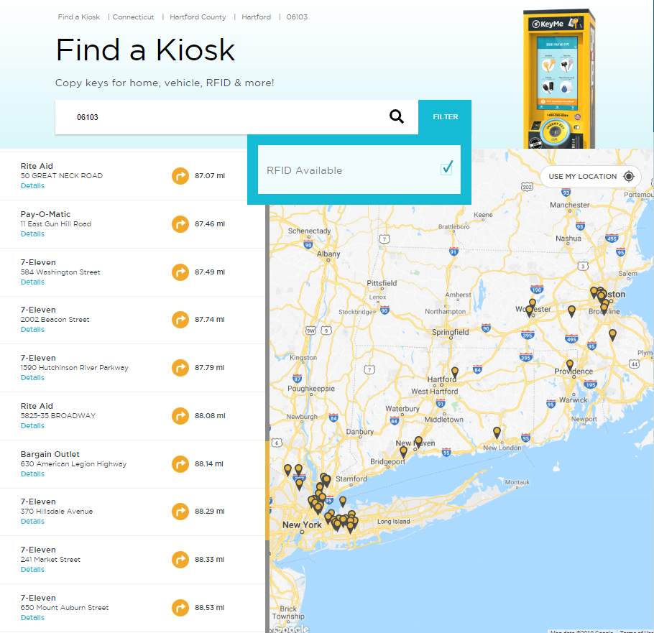
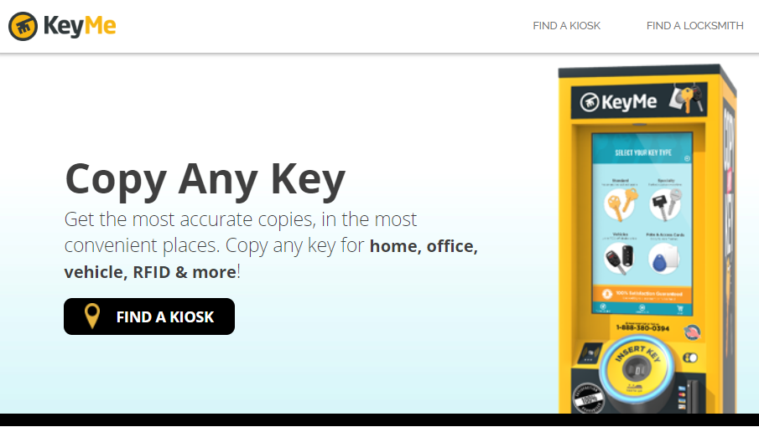
Credential Vulnerabilities – Cloning Kiosks

Slide 14
Common Mistakes on ‘Secure’ Credentials
Reading insecure, unauthenticated Card Serial Number
Poor Key Management or Standard/Default keys
Unencrypted data payload
Credential number marked on the card
Open, untracked credential format
Reader configuration supporting secure credentials alongside legacy
Unencrypted communication from reader to panel

Slide 15
Reader/Panel Communication Vulnerabilities
Publically available products designed to spoof valid credential transactions

Slide 16
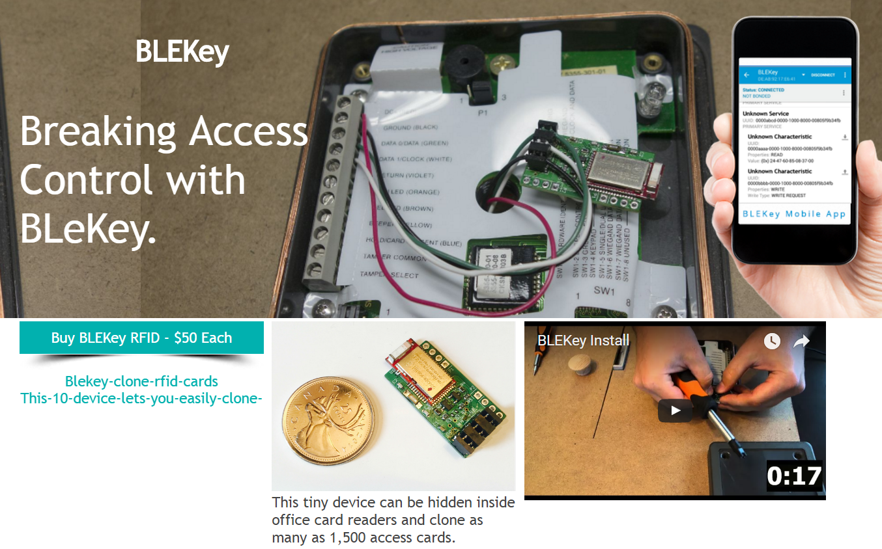
Weigand Vulnerability

Slide 17

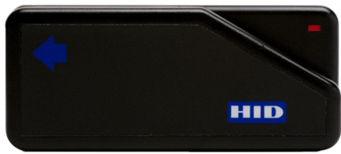
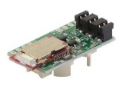


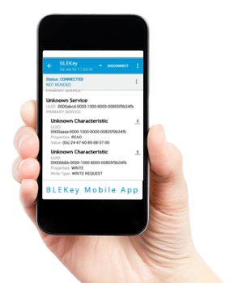
Weigand Vulnerability
Wiegand Card
Door Controller
Data 0
Parity Bits – No Error
Facility Code – 01111011 = 123
Card Number – 0010011010010100 = 9876
Data 1
10111101100100110100101000
10111101100100110100101000

Slide 18
Discussion Questions
What suggestions do you have for better interaction with the team?
What suggestions do you have for the coming year?

Slide 19
THANK YOU!

